Slide 1
Restaurant Database Management System.
Lasya Manthripragada
NUid: 002130377
Course_ID: DS5110
Course_Name: IDMP

Slide 2
Contents
ER diagram
Strong Entities
Weak Entities
Manager
Chef
Customer
Data Visualization
Future scope
Conclusion

Slide 3
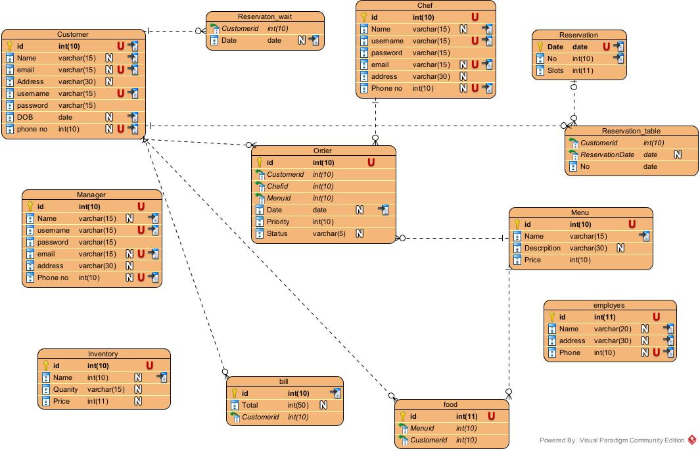
Restaurant database system ER diagram

Slide 4
Database: Strong entities
Customers
Manager
Chef
Employees
Reservation
Inventory
Menu

Slide 5
Database: Weak entities
Reservation_table
Order
Food
Bill

Slide 6
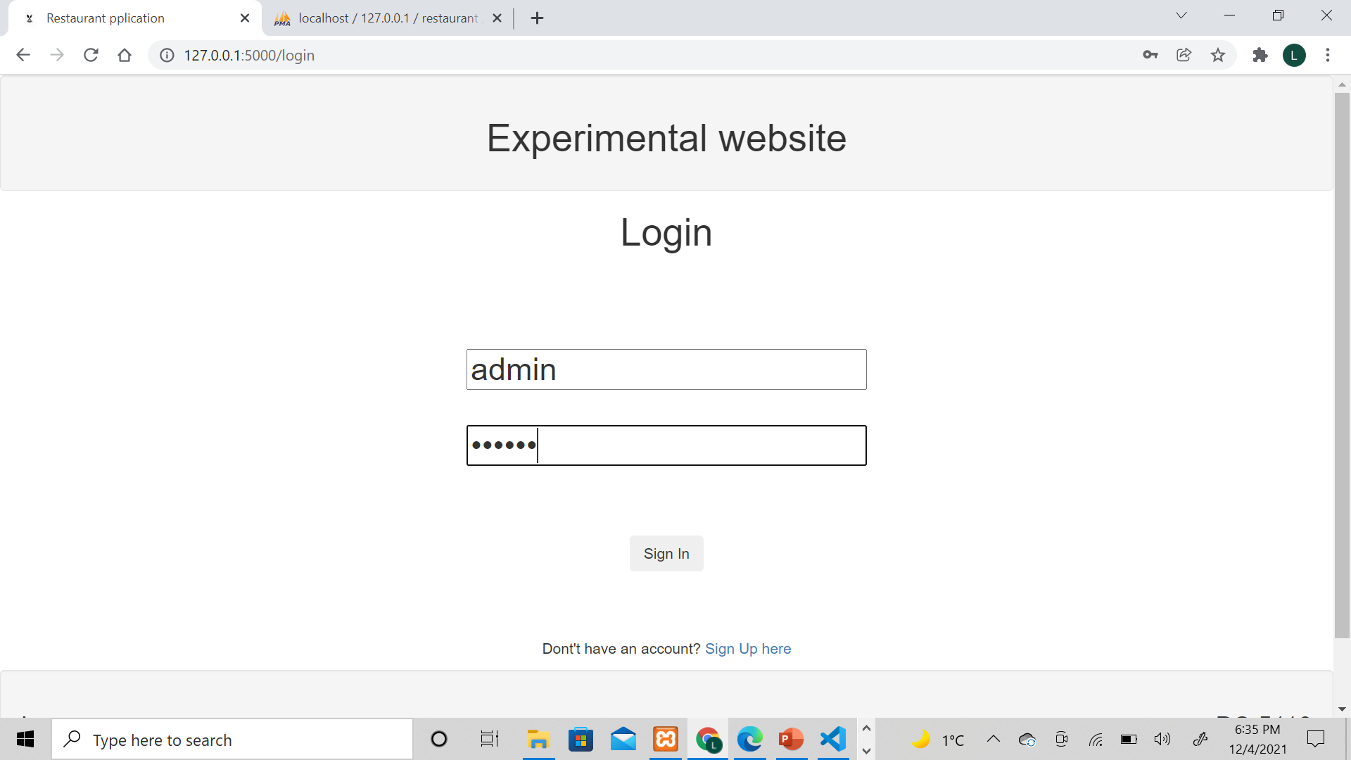
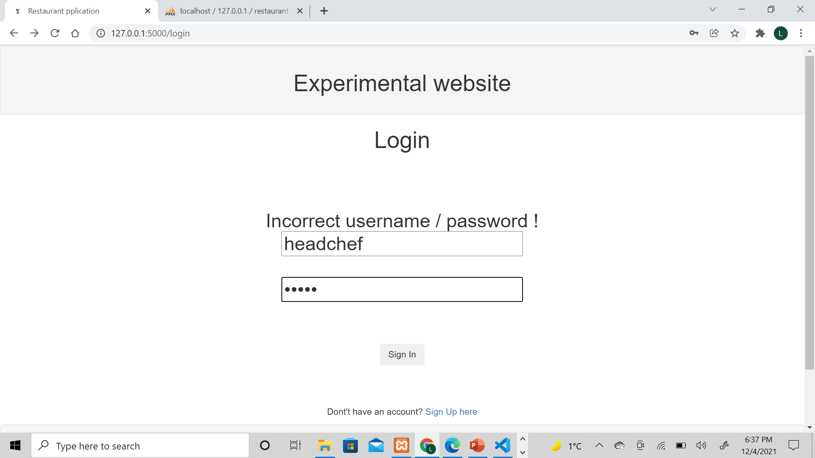
Login Page
Web Framework: Flask
Database: PHPMyAdmin
Chef LOGIN
Admin

Slide 7
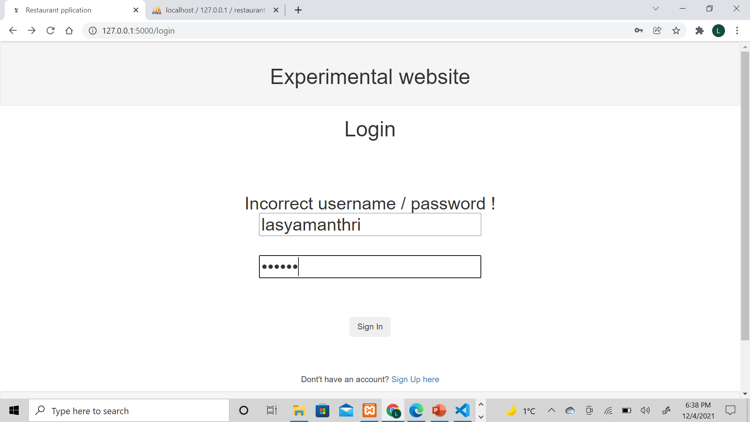
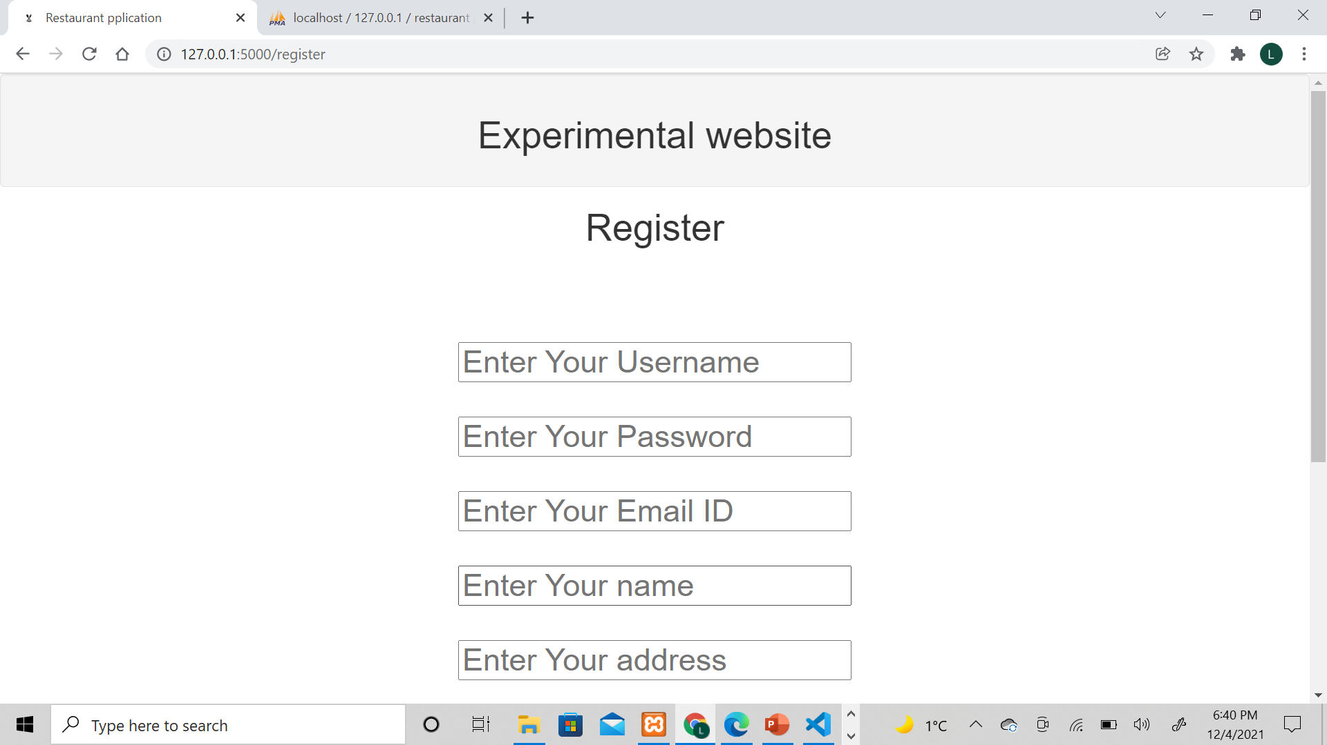
Customers
Login
Registration

Slide 8
Procedures/Functions/Triggers/Transactions/Views
Applications consists of 4 functions which return the no.of unique values in each of the tables. This is useful to plot graphs.
Customers
Employers
Managers
Chef
There are login views containing only the username and password of the user.
Whenever, reservation_table gets updated, the date and time slot for that reserved date is decremented, on which trigger was created
Manage can perform CRUD operations, so for each time he modifies/inserts something, if there is an error, it should rollback, otherwise commit.

Slide 9
Procedures/Functions/Triggers/Transactions/Views
There are 5 procedures:
The first procedure returns a table with the customers’ reservation history. It takes the customer id as the input.
The second procedure returns a table with chef’s order history for a particular day. It takes the chef id as the input along with the date
The third procedure takes the date and time and gives the no.of reservations for that day, which is one of the functionality in admin page
The fourth one takes the date and returns the total amount earned by the restaurant (calculated from bill/check table) on that day.
The final one takes date as an input and returns a table of customers who have their birthdays on the same day, this may help to give a discount or offer something special to the customer, it is a marketing strategy.

Slide 10
Manager
Manager can insert, modify, and delete data from
Menu
Inventory
Chefs
Employees
Reservation slots
Manager can view customers but cannot modify or delete the entries.
He can also view
Daily sales
Frequent customers
Manager vs Chef vs Employee Ratio
Frequently ordered menu items

Slide 11
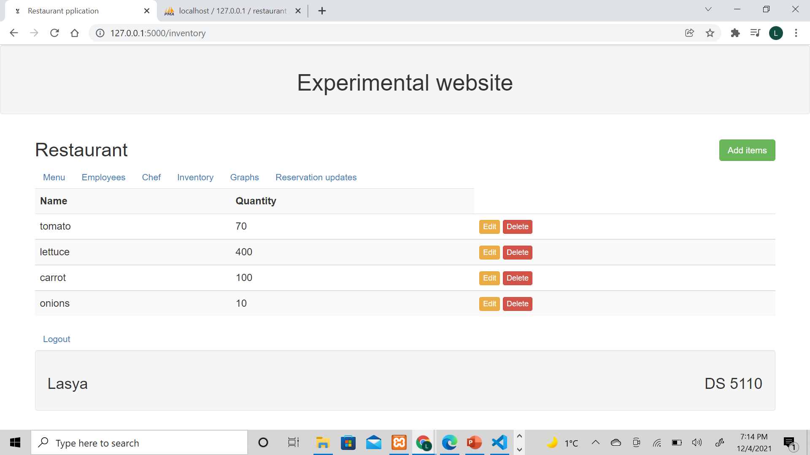
Manager
Manager can do CRUD operations.
Manager cannot change or modify passwords for chef, but they can make register.

Slide 12
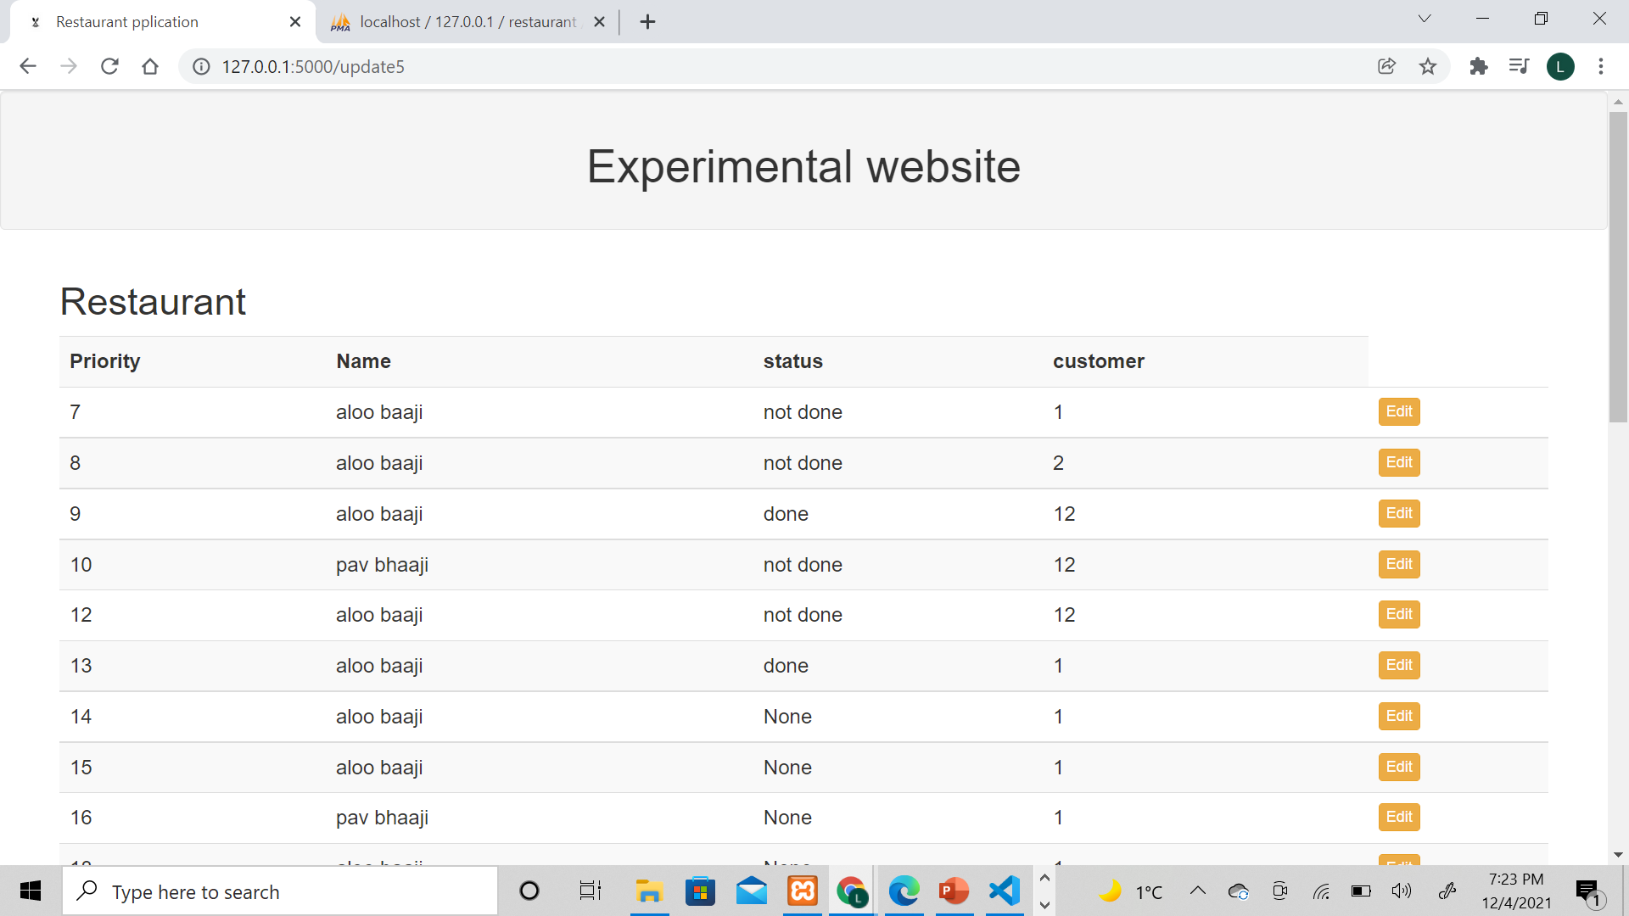
Chef
Chefs can view the orders assigned to them. They can change the status of the order after it is done. The priority is high when the value is the least.

Slide 13
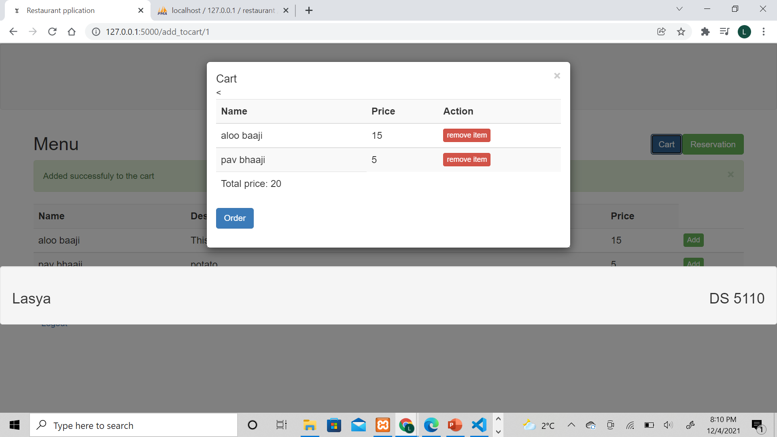
Customer
Customers can make reservations. Only after making a successful registration, they can order food.

Slide 14
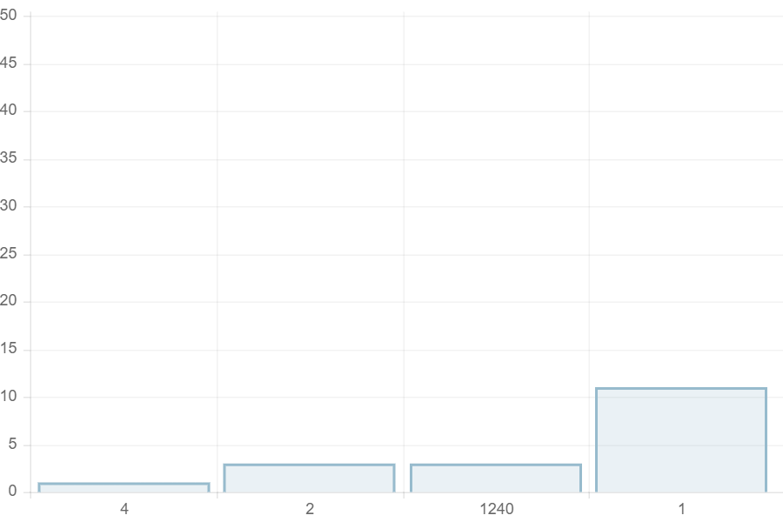
Data visualization
Top 5 frequent customers to the restaurant.

Slide 15
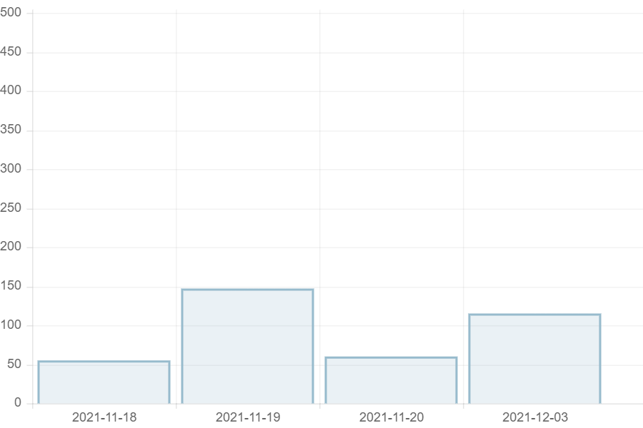
Data visualization
Daily sales

Slide 16
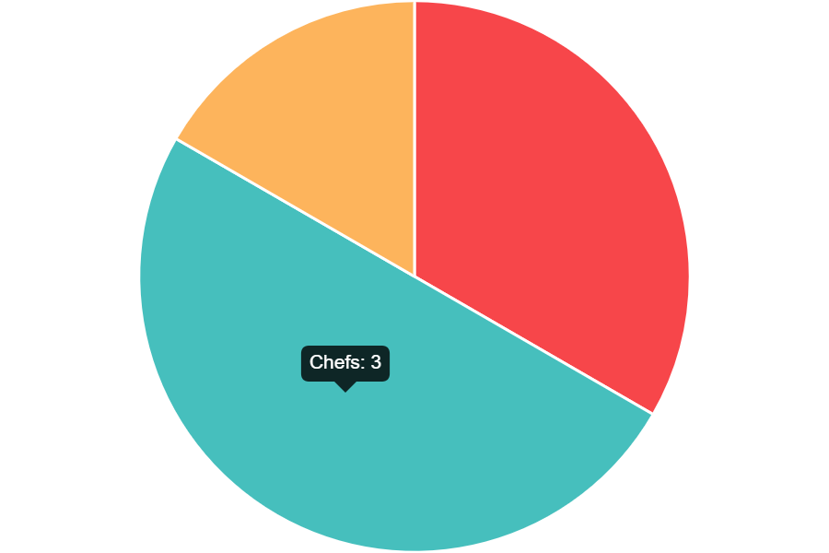
Data visualization
Chefs' vs Manager vs Employees

Slide 17
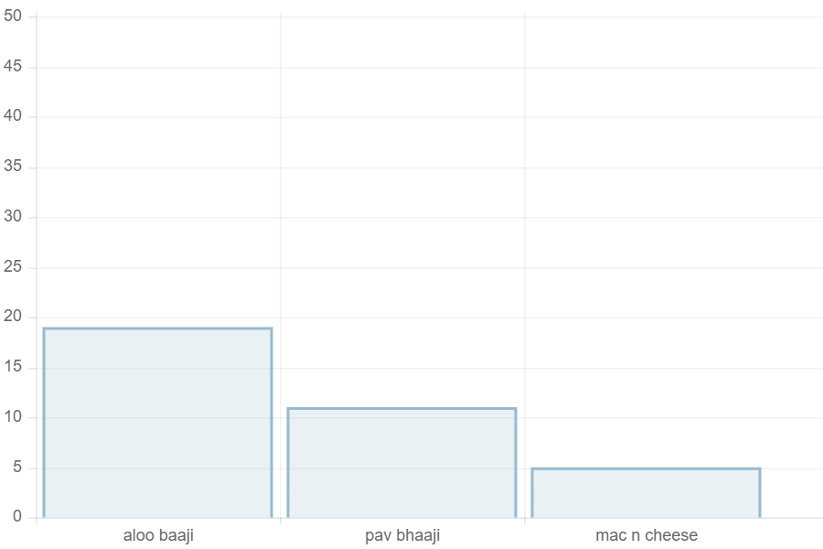
Data visualization
No. of times an item from the menu is ordered.
This way we can identify the most famous order.

Slide 18
Future Scope
Once customers cannot reserve a table, they have no option but to try again. Hence, a waiting list can be developed so that each customer has first come first serve service when it comes to reserve a table.
Manager cannot register, rather the database administrator should upload the details and provide credentials to the manager. Instead, we can give the manager a code through which (if the code is valid) , manager will be directed to the manager registration portal.
Also, the salaries, building rent are not recorded anywhere, if we can add that data, we can estimate profits more efficiently.

Slide 19
Conclusion
The restaurant database application can register a customer, and customer can log in to the system. Once logged in, they can view the menu. However, to order, they need to book a table, which functionality is also specified.
Chef can login, the credentials are given by the manager. They can view the orders assigned to them and change their status once they are done making them i.e., ready to be served.
Manager can view/insert/modify menu, inventory, employers, chef, reservation slots data through CRUD operations.
Manager can also visualize the data. Such as, daily sales, frequently ordered item in the menu, and most frequently visited customers.

Slide 20
THANK YOU.
ANY QUESTIONS?

